Slide 1
From Theory to Practice: How to achieve a digital Interdisciplinary Model of Care
Robert Nieves, Juris Doctor, MBA, MPA, BSN, RN, VP Health Informatics

Slide 2
Robert Nieves, Juris Doctor, MBA, MPA, BSN, RN Vice President Health Informatics
Clinical Experience:
27 years as a Registered Nurse
Clinical Areas:
Cardio Thoracic ICU
Emergency Room
Long Term Care
Community Case Management
Home Care
Clinical Informatics:
16 year in Informatics
EHR platforms
Epic
Allscripts SCM
McKesson HED
Meditech
Cerner
HP
Infomedika
ISH Med
Self Built
12 years with Elsevier

Slide 3
Nursing Informatics
Nursing informatics (NI) is the specialty that integrates nursing science with multiple information management and analytical sciences to identify, define, manage, and communicate data, information, knowledge, and wisdom in nursing practice.
NI supports nurses, consumers, patients, the interprofessional healthcare team, and other stakeholders in their decision-making in all roles and settings to achieve desired outcomes.
This support is accomplished through the use of:
information structures
information processes
information technology
One of the most recognized applications for clinical informatics is the Electronic Health Record (EHR)

Slide 4
Data
People
Systems
Informatics

Slide 5
Data
Information
Knowledge
Wisdom
Content
Practice
Workflow
HIS

Slide 6
Clinical Decision Support (CDS)
CDS is not simply an alert, notification, or explicit care suggestion.
CDS encompasses a variety of tools including, but not limited to:
Computerized alerts and reminders for providers and patients
Clinical guidelines/ Care Plans
Condition-specific order sets
Focused patient data reports and summaries
Documentation templates
Diagnostic support
Contextually relevant reference information
Improving Outcomes with Clinical Decision Support: An Implementer’s Guide (Second edition, 2011): published by HIMSS © 2011 by the Healthcare Information and Management Systems Society (HIMSS)

Slide 8
Clinical Team at the bedside
=
Fighter Pilots

Slide 9
Globally, it is widely accepted that 10% of inpatient admissions are associated with adverse events.
The incremental total cost of adverse events was € 88,268,906.
200,000 a 400,000 deaths are cause by an adverse event.
28% of patients suffer one or more injuries related to medication errors.
The incidence of preventable adverse events is estimated between 30 and 52%.
Notes:
Is your Intensive Care Unit like most across the world, taking a chest X-ray of every ICU patient every day? Is a daily chest X-ray really necessary for every ICU patient every day?
If a colon cancer patient came to receive treatment from a surgeon, would the surgeon know that because the patient is 52 years old, and because the cancer is located in the right side of the colon, that the normal colon cancer operation is wrong? That this patient has a genetically inherited cancer syndrome and needs a much larger operation? And that the patient needs screening for cancer in other organ systems? And that all of the patient’s children, siblings, and parents need a blood test to see which of them also has the cancer syndrome?

Slide 10
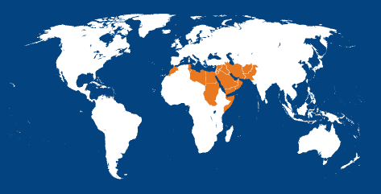
Eastern Mediterranean Region
18% of hospital admissions are associated with adverse events and about
3% of hospital admissions are associated with an adverse event that is severe enough to cause death or permanent disability.
83% of recorded adverse events are judged to be preventable.
Notes:
Is your Intensive Care Unit like most across the world, taking a chest X-ray of every ICU patient every day? Is a daily chest X-ray really necessary for every ICU patient every day?
If a colon cancer patient came to receive treatment from a surgeon, would the surgeon know that because the patient is 52 years old, and because the cancer is located in the right side of the colon, that the normal colon cancer operation is wrong? That this patient has a genetically inherited cancer syndrome and needs a much larger operation? And that the patient needs screening for cancer in other organ systems? And that all of the patient’s children, siblings, and parents need a blood test to see which of them also has the cancer syndrome?

Slide 11
What we know…
The cause of Preventable Adverse Events in hospitals may be separated into these categories:
Errors of commission
Errors of omission
Errors of communication
Errors of context
Diagnostic errors
James, John T. PhD, A New, Evidence-based Estimate of Patient Harms Associated with Hospital Care, Journal of Patient Safety: September 2013 - Volume 9 - Issue 3 - p 122–128
Notes:
Contextual errors occur when a physician fails to take into account unique constraints in a patient’s life that could bear on successful, post discharge treatment. For example, the patient may lack the cognitive ability to comply with a medical treatment plan or may not have reasonable access to follow-up care.

Slide 12
Errors of Commission
Lantus Insulin 8 units
Lantus Insulin 80 units

Slide 13
What we know…
Error of Omission: is forgetting to do something like a task or intervention
These lead to injuries arising from the patient’s underlying disease that could have been prevented by optimal care.
According to AHRQ, omissions are more difficult to recognize but represent a larger problem
Nine documentation elements regularly missed:
Ambulation | Emotional Support
Turning | Hygiene
Delayed or missed feedings | Intake & Output
Patient Teaching | Surveillance
Discharge Planning
Beatrice J. Kalisch, Gay Landstrom, Reg Arthur Williams, Missed nursing care: Errors of omission, Nursing Outlook, Volume 57, Issue 1, January–February 2009, Pages 3-9
Notes:
A sample of 459 nurses in 3 hospitals completed the Missed Nursing Care (MISSCARE) Survey. Assessment was reported to be missed by 44% of respondents while interventions, basic care, and planning were reported to be missed by > 70% of the survey respondents. Reasons for missed care were labor resources (85%), material resources (56%), and communication (38%).
According to the Agency for Healthcare Research and Quality, “errors of omission are more difficult to recognize than errors of commission but likely represent a larger problem. In other words, there are probably many more instances in which the provision of additional nursing care, such as turning and patient teaching in preparation for discharge, would have improved outcomes than there are instances in which the care provided caused direct harm (such as giving the wrong dose of a medication).
Nine elements of regularly missed nursing care (ambulation, turning, delayed or missed feedings, patient teaching, discharge planning, emotional support, hygiene, intake and output documentation, and surveillance) and 7 themes relative to the reasons nursing staff gave for missing this care (too few staff, poor use of existing staff resources, time required for the nursing intervention, poor teamwork, ineffective delegation, habit, and denial) were uncovered.
Beatrice J. Kalisch, Gay Landstrom, Reg Arthur Williams, Missed nursing care: Errors of omission, Nursing Outlook, Volume 57, Issue 1, January–February 2009, Pages 3-9, ISSN 0029-6554, http://dx.doi.org/10.1016/j.outlook.2008.05.007. (http://www.sciencedirect.com/science/article/pii/S0029655408001462

Slide 14
What we know…
Error of Omission: is forgetting to do something like a task or intervention
These lead to injuries arising from the patient’s underlying disease that could have been prevented by optimal care.
According to AHRQ, omissions are more difficult to recognize but represent a larger problem
Nine documentation elements regularly missed:
Ambulation | Emotional Support
Turning | Hygiene
Delayed or missed feedings | Intake & Output
Patient Teaching | Surveillance
Discharge Planning
Beatrice J. Kalisch, Gay Landstrom, Reg Arthur Williams, Missed nursing care: Errors of omission, Nursing Outlook, Volume 57, Issue 1, January–February 2009, Pages 3-9
Notes:
A sample of 459 nurses in 3 hospitals completed the Missed Nursing Care (MISSCARE) Survey. Assessment was reported to be missed by 44% of respondents while interventions, basic care, and planning were reported to be missed by > 70% of the survey respondents. Reasons for missed care were labor resources (85%), material resources (56%), and communication (38%).
According to the Agency for Healthcare Research and Quality, “errors of omission are more difficult to recognize than errors of commission but likely represent a larger problem. In other words, there are probably many more instances in which the provision of additional nursing care, such as turning and patient teaching in preparation for discharge, would have improved outcomes than there are instances in which the care provided caused direct harm (such as giving the wrong dose of a medication).
Nine elements of regularly missed nursing care (ambulation, turning, delayed or missed feedings, patient teaching, discharge planning, emotional support, hygiene, intake and output documentation, and surveillance) and 7 themes relative to the reasons nursing staff gave for missing this care (too few staff, poor use of existing staff resources, time required for the nursing intervention, poor teamwork, ineffective delegation, habit, and denial) were uncovered.
Beatrice J. Kalisch, Gay Landstrom, Reg Arthur Williams, Missed nursing care: Errors of omission, Nursing Outlook, Volume 57, Issue 1, January–February 2009, Pages 3-9, ISSN 0029-6554, http://dx.doi.org/10.1016/j.outlook.2008.05.007. (http://www.sciencedirect.com/science/article/pii/S0029655408001462

Slide 15
Is all variability bad?
Acceptable variability = Personalised care.

Slide 16
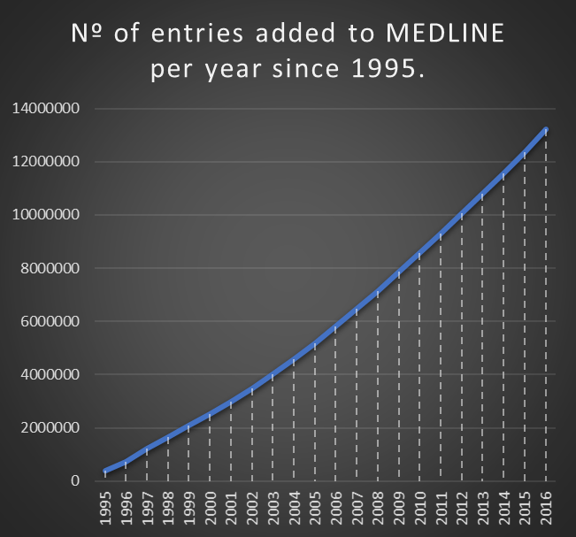
“lack of knowledge is the factor that most contributes to the occurrence of adverse events caused by misdiagnosis, more than in any other area regarding patient safety.”
REV ASSOC MED BRAS. 2013;59(5):421-428
KNOWLEDGE VARIABILITY
Two citations are added to MEDLINE
every minute!

Slide 17
Notes:
To help with these rule based errors, a checklist serves as a memory aid
Reminds people of the rule, such as if my patient has a heart attack, I should consider doing the things on this list.
Do you expect a pilot of an airliner to use a checklist every time he or she lands a plane? Yes, and they do even if they have landed 10,000 times.
Forgetting one item on the list could be catastrophic.

Slide 18
Current
Credible
Evidence Based Practice
Clinical Decision Support (CDS):
Notes:
The most impactful way to empower providers and patients
in reducing variability…

Slide 19
From Theory to Practice

Slide 20
Data
Information
Knowledge
Wisdom
Allows collection of raw facts
Create meaning
Analysis & Synthesis
Clinical Judgement/Evaluation
Types
Methods
Sequence
Relationships
Connections
Rationale
Measurements
Results
Numeric
Calculations
Structured
Free Text
Respiratory Assessments
Lung Sounds
Rhythm/Pattern
Sputum
Signs & Symptoms that indicate Respiratory Compromise:
Dyspnea
Cyanosis
Irritability
Confusion
Problem:
Respiratory Compromise
Objective/Goal:
Effecitive Ventilation & Oxygenation

Slide 21
Data Quality
Structured
In Context
Respiratory Rhythm/Pattern
apnea
dyspnea
bradyapneic
adequate chest movement
hiccups
irregular
shortness of breath
mechanical assistance
SOB
Dyspneic
Short of Breath
Shortness of Breath
Dyspnea

Slide 22
Data Quality
Cognitive
Level of consciousness
Arousal level
Orientation
Mood
confused
Connections and context of the data
restless
Respiratory Compromise
Respiratory
Respiratory Rhythm/Pattern
Nailbeds
Mucous membranes
shortness of breath
cyanotic
Cardiovascular
Cardiac Rhythm
Heart Sounds
tachycardic

Slide 23
PATIENT
PROFILE
GENERAL HEALTH
Health Maintenance Behaviors:
healthy diet, social activities
Normal Bedtime/Wake Time:
11:00 pm to 7:00 am
Healing Pattern: Unsure
Sleep Aids/Routine: Dark room, music
Usual Activity Tolerance: Good
RISK SCREENS
Nutrition Risk Screen: No indicators present
Depression Screen:
Over the past 2 weeks, have you felt down, depressed or hopeless?: No
Over the past 2 weeks, have you felt little interest or pleasure in doing things?: No
Name: Walter Jones
Gender: Male
Age: 65
Height: 6' 2"
Weight: 210 lbs.
Pneumonia
Primary Physician: Dr. Smith
Allergies: No Known Allergies
Pressure Ulcer POA: Negative
Last Braden Risk Score: 10
Fall Risk Score: 6
Last Pain Score: 5 (0-10)
HEALTH MANAGEMENT
Symptoms/Conditions Managed at Home:
Hypertension
Barriers to Managing Health: None
Cardiovascular Management Strategies:
Diet modification; medication therapy
RELATIONSHIP/ENVIRONMENT
Primary Source of Support/Comfort:
Spouse, children (1 daughter, 2 sons)
Environment Concerns: None
Lives With: Wife, Joan
Financial Concerns: None
Primary Roles/Responsibilities: Retired
Home Accessibility Concerns:
Stairs to enter home; stairs within home

Slide 24
PLAN
OF
CARE
PLAN OF CARE
Potential Problems:
Suggested Care Plans:
Pneumonia
Fall Injury Risk
Skin Injury Risk
Name: Walter Jones
Gender: Male
Age: 65
Height: 6' 2"
Weight: 210 lbs.
Pneumonia
Primary Physician: Dr. Smith
Allergies: No Known Allergies
Pressure Ulcer POA: Negative
Last Braden Risk Score: 10
Fall Risk Score: 6
Last Pain Score: 5 (0-10)

Slide 25
PLAN
OF
CARE
PLAN OF CARE
Potential Problems:
Suggested Care Plans:
Pneumonia
Fall Injury Risk
Skin Injury Risk
Respiratory Compromise
Infection Progression
Fluid/Electrolyte Imbalance
Name: Walter Jones
Gender: Male
Age: 65
Height: 6' 2"
Weight: 210 lbs.
Pneumonia
Primary Physician: Dr. Smith
Allergies: No Known Allergies
Pressure Ulcer POA: Negative
Last Braden Risk Score: 19
Fall Risk Score: 6
Last Pain Score: 5 (0-10)

Slide 26
PLAN
OF
CARE
PLAN OF CARE
Potential Problems:
Suggested Care Plans:
Pneumonia
Fall Injury Risk
Skin Injury Risk
Respiratory Compromise
Infection Progression
Fluid/Electrolyte Imbalance
Name: Walter Jones
Gender: Male
Age: 65
Height: 6' 2"
Weight: 210 lbs.
CABG
Primary Physician: Dr. Smith
Allergies: No Known Allergies
Pressure Ulcer POA: Negative
Last Braden Risk Score: 19
Fall Risk Score: 6
Last Pain Score: 5 (0-10)

Slide 27
PLAN
OF
CARE
PLAN OF CARE
Potential Problems:
Suggested Care Plans:
Pneumonia
Fall Injury Risk
Skin Injury Risk
Respiratory Compromise
Infection Progression
Fluid/Electrolyte Imbalance
Clinical Guidance
Name: Walter Jones
Gender: Male
Age: 65
Height: 6' 2"
Weight: 210 lbs.
CABG
Primary Physician: Dr. Smith
Allergies: No Known Allergies
Pressure Ulcer POA: Negative
Last Braden Risk Score: 19
Fall Risk Score: 6
Last Pain Score: 5 (0-10)
Promote pulmonary hygiene and secretion clearance.
Monitor and manage pain and anxiety to avoid respiratory compromise.
Encourage repositioning to maximize ventilation.
Monitor and manage fluid balance.
Encourage activity and mobility per patient tolerance.
Monitor medication effects (e.g., inhaled, analgesic, anxiolytic).
Anticipate need for additional respiratory support.
Goal:
By transition of care the patient will achieve the following goal:
Effective Oxygenation & Ventilation
ETC..
Problem Intervention:
Optimize Oxygenation & Ventilation
Airway ventilation management
Head of Bed (HOB) position

Slide 28
PLAN
OF
CARE
PLAN OF CARE
Potential Problems:
Suggested Care Plans:
Pneumonia
Fall Injury Risk
Skin Injury Risk
Respiratory Compromise
Infection Progression
Fluid/Electrolyte Imbalance
Name: Walter Jones
Gender: Male
Age: 65
Height: 6' 2"
Weight: 210 lbs.
CABG
Primary Physician: Dr. Smith
Allergies: No Known Allergies
Pressure Ulcer POA: Negative
Last Braden Risk Score: 19
Fall Risk Score: 6
Last Pain Score: 5 (0-10)
Goal:
By transition of care the patient will achieve the following goal:
Effective Oxygenation & Ventilation
Airway Ventilation Management
airway patency maintained
calming measures promoted
humidification applied
pulmonary hygiene promoted
Problem Intervention:
Optimize Oxygenation & Ventilation
Airway ventilation management
Head of Bed (HOB) position
➲

Slide 29
PLAN
OF
CARE
PLAN OF CARE
Potential Problems:
Care Plans:
Pneumonia
Fall Injury Risk
Skin Injury Risk
Plan of Care
Problem
Respiratory Compromise
Infection Progression
Fluid/Electrolyte Imbalance
Goal:
By transition of care the patient will achieve the following goal:
Effective Oxygenation & Ventilation
Goal
Problem Intervention:
Optimize Oxygenation & Ventilation
Airway ventilation management
Head of Bed (HOB) position
Problem Intervention
Interventions
Airway Ventilation Management
airway patency maintained
calming measures promoted
humidification applied
pulmonary hygiene promoted
Intervention

Slide 30
.
“the adoption by the clinical care team of one appropriate specific management plan will, by virtue of standardization alone, yield results superior to those achieved by random application of several individually equivalent approaches.”
Number 629, April 2015, Committee on Patient Safety and Quality Improvement Committee on Professional Liability

Slide 31
The “CDS Five Rights”
The CDS Five Rights concept states that in order to provide benefits, CDS must provide:
Right Information
Right
People
Right
Channels
Right
Interventions
Right
Point in Workflow

Slide 32
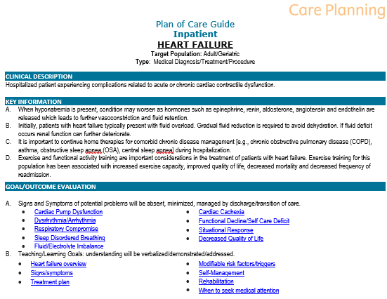
The “CDS Five Rights”
The CDS Five Rights concept states that in order to provide benefits, CDS must provide:
Right Information
Right
People
Right
Channels
Right
Interventions
Right
Point in Workflow

Slide 33
The “CDS Five Rights”
The CDS Five Rights concept states that in order to provide benefits, CDS must provide:
Right Information
Right
People
Right
Channels
Right
Interventions
Right
Point in Workflow
Interdisciplinary Team
Nursing
Physical Therapy
Occupational Therapy
Speech Language Pathology
Dietician
Pharmacy
Social Work/Case Management
Pastoral/Spiritual Care
Physicians






Slide 34
The “CDS Five Rights”
The CDS Five Rights concept states that in order to provide benefits, CDS must provide:
Right Information
Right
People
Right
Channels
Right
Interventions
Right
Point in Workflow
1 Care Plan
Patient Centered
Interdisciplinary
Standardizes Care by reducing variability
Facilitates Transitions
Evidence-Based

Slide 35
The “CDS Five Rights”
The CDS Five Rights concept states that in order to provide benefits, CDS must provide:
Right Information
Right
People
Right
Channels
Right
Interventions
Right
Point in Workflow

Slide 36
The “CDS Five Rights”
The CDS Five Rights concept states that in order to provide benefits, CDS must provide:
Right
Information
Right
People
Right
Channels
Right
Interventions
Right
Point in Workflow

Slide 37
What do you need
Informatics Theory
Standardization
Individualization
Patient Centered Care
Interdisciplinary Plan of Care Process
Evidence Based Practice
Clinical Decision Support
Content
Practice
Clinical Ownership

Slide 38
Transformation starts with each one of us…

Slide 39
Thank You! r.nieves@elsevier.com
Robert Nieves, Juris Doctor, MBA, MPA, BSN, RN
Vice President Health Informatics

